Slide 1


Slide 2
Chapter 8
FUNCTIONS
Brief Summary of Chapter 8
In this lesson, we will be covering functions, which are blocks of reusable code designed to perform a specific task. Functions allow us to write code once and call it multiple times, improving code organization and efficiency. We will explore how to define functions with parameters, pass arguments to them, and return values. Additionally, we will look at how to pass and modify lists in functions, as well as ways to prevent a function from changing the original list. We will also learn about handling an unknown number of arguments using *args and **kwargs, and how to store functions in separate modules for reuse in different programs. Lastly, we will examine different methods of importing functions and applying aliases.

Slide 3
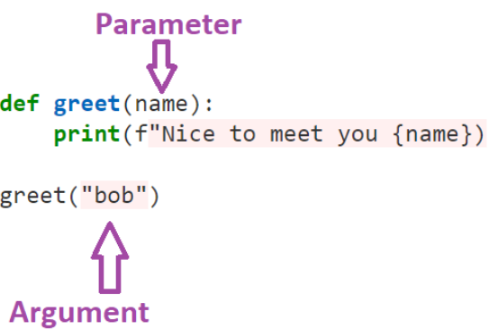
Defining a Function
A parameter is a variable in the function definition that acts as a placeholder for values. When you define a function, you specify parameters, which are essentially placeholders for data. An argument is the actual value you provide when calling the function.
For example:

Slide 4
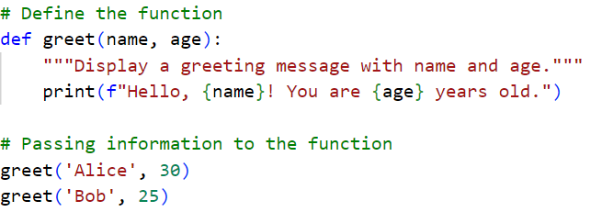
Here's an example that defines a function, passes information to it, and demonstrates arguments and parameters:
In this example, we define a function called greet(), which takes two parameters: name and age. When we call the function with greet('Alice', 30), 'Alice' and 30 are the arguments being passed to the function. These arguments are assigned to the parameters name and age inside the function, and the function then prints a greeting message using those values.

Slide 5
Passing Arguments
Positional arguments are values passed to a function in the exact order that the parameters are defined in the function. Each argument is assigned to the corresponding parameter based on its position in the function call. You can think of positional arguments as a way of matching values to the function's parameters by "slot," where the first argument fills the first parameter, the second argument fills the second parameter, and so on.
Keyword arguments allow you to specify each argument by name, making the order irrelevant and clarifying what each value represents. Default values provide predefined values for parameters, so if an argument is not passed in a function call, the default is used.
Equivalent function calls refer to different ways of calling a function using a mix of positional arguments, keyword arguments, and default values, where the function behaves the same as long as the required arguments are provided correctly. You can think of equivalent function calls as different approaches to supplying arguments that lead to the same result, offering flexibility in how you call the function.

Slide 6
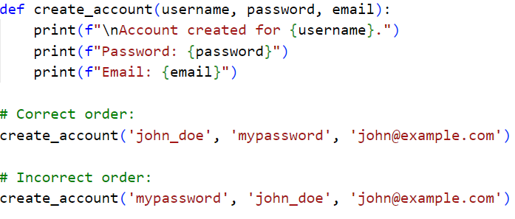
Positional Arguments & Order Matters in Positional Arguments

Slide 7
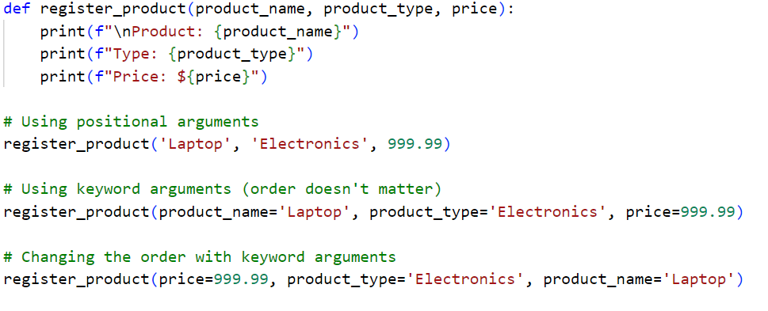
Keyword Arguments & Equivalent Function Calls

Slide 8
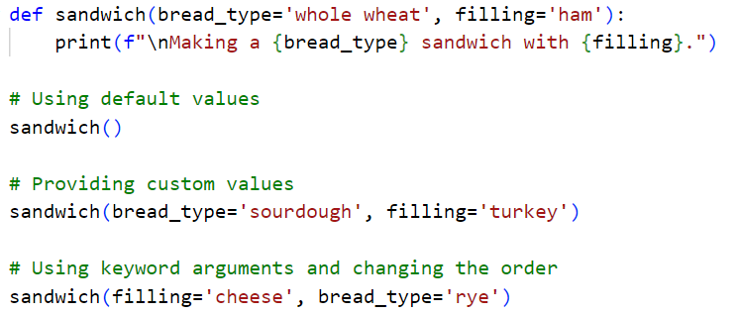
Default Values & Equivalent Function Calls

Slide 9
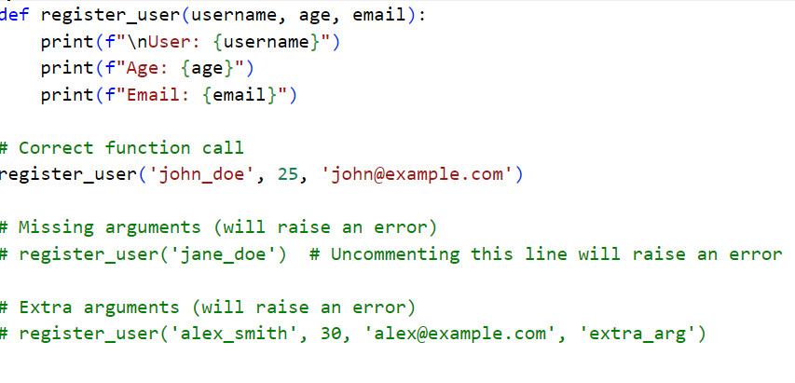
Avoiding Argument Errors & Multiple Function Calls

Slide 10
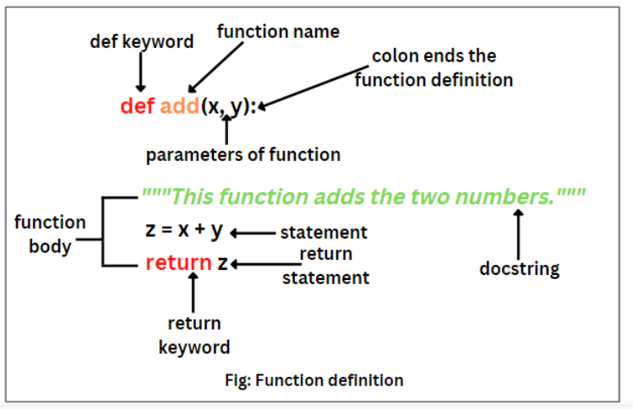
Return Values
The return statement in Python sends a value from a function back to where it was called, allowing the result to be used elsewhere in the program. It is important for optional arguments (which are function parameters with default values) because it lets the function handle different inputs and return a result whether or not the argument is provided. For example, a function can store key-value pairs, like a person’s first and last name, in a dictionary and return it.

Slide 11
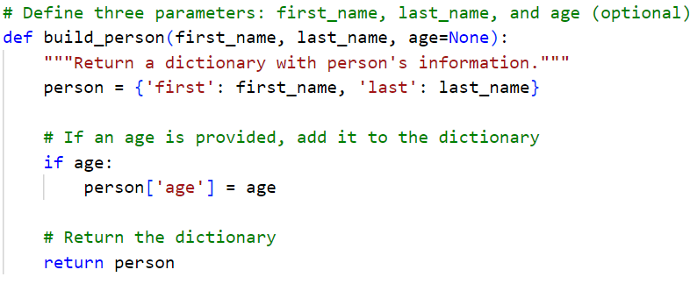
The function build_person creates a dictionary with a person's first and last name. The age parameter is optional. If provided, the age is added to the dictionary. The function then returns the dictionary with the person's information.

Slide 12
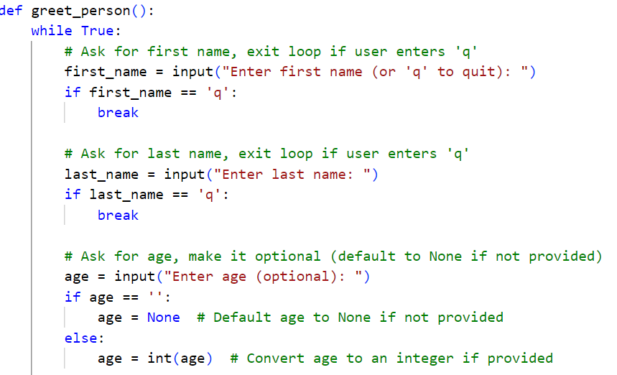
The greet_person function repeatedly asks the user for their first name, last name, and optionally age. It creates a dictionary with the details using build_person, then displays a greeting and age (if provided). The loop ends when the user enters 'q'.

Slide 13
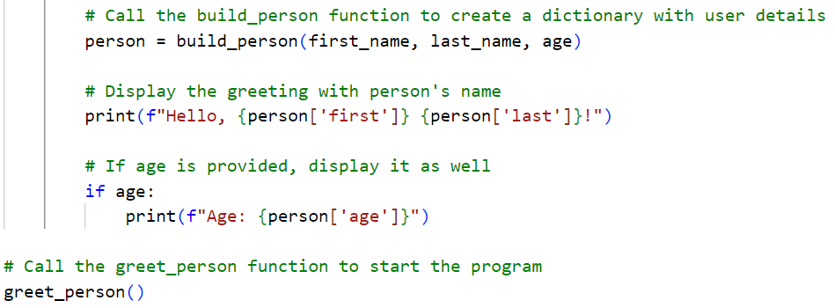

Slide 14
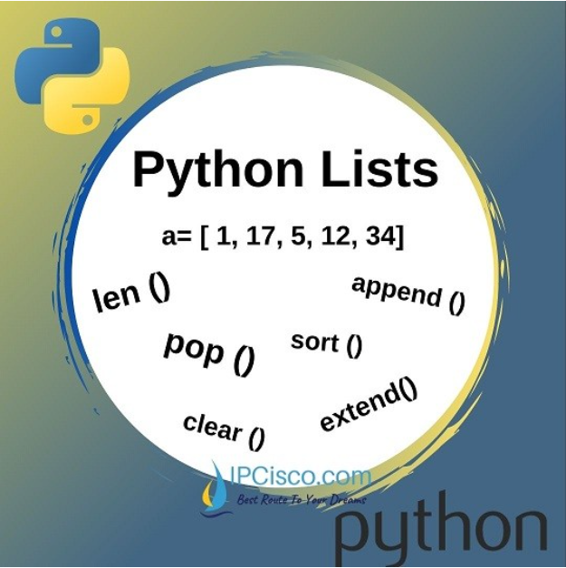
Passing a List
The greet_users() function takes a list of names and prints a greeting for each user, without changing the list. The print_models() function prints designs by removing items from the original list and adding them to the new list, permanently changing the original list. To prevent a function from changing the original list, you can pass a copy of the list using slice notation (list[:]), keeping the original list the same.

Slide 15
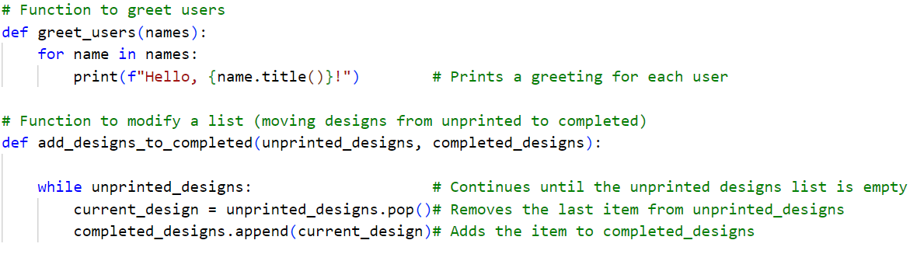
The code shows three functions: one that greets users from a list, one that modifies a list by moving items to a new list, and one that prevents modifying the original list by using a copy.

Slide 16
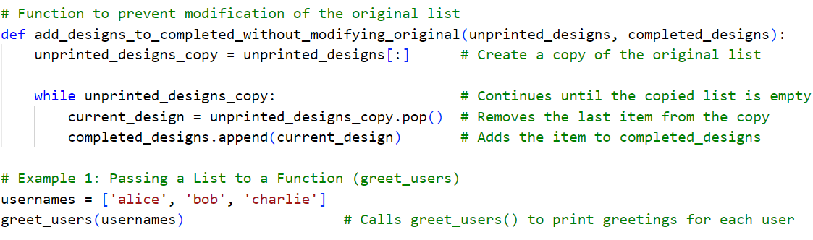

Slide 17
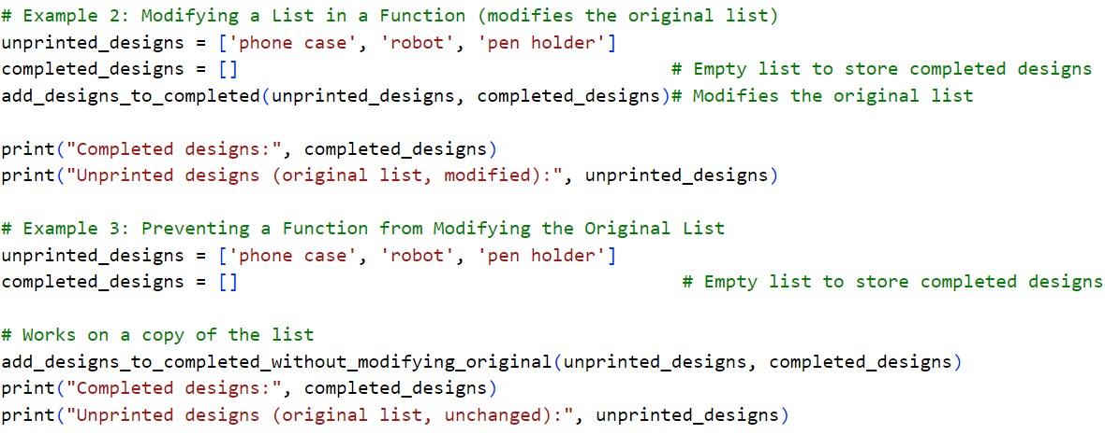

Slide 18
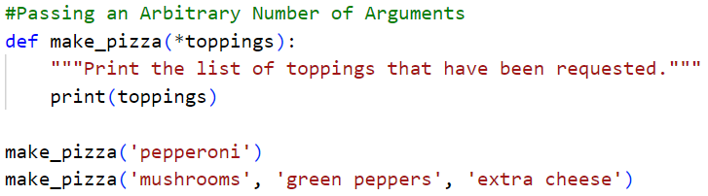
Passing a Flexible Number of Arguments (Page 146 - 148)
This code defines a function, make_pizza(), that accepts an arbitrary (flexible) number of toppings by using the *toppings syntax (* before a parameter means the function can accept any number of inputs). When the function is called, it collects all provided arguments into a tuple and prints it. In the example, calling make_pizza('pepperoni') prints a tuple with one topping, while calling make_pizza('mushrooms', 'green peppers', 'extra cheese') prints a tuple with three toppings.

Slide 19
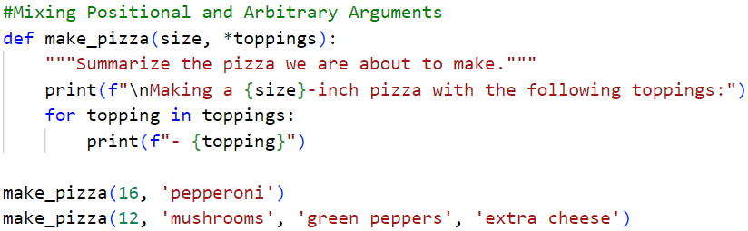
This code defines a function, make_pizza(size, *toppings), where size is a required argument for the pizza's size, and *toppings allows for any number of additional toppings. When the function is called, it first prints the size of the pizza, then loops through the toppings tuple to print each topping. In the first function call (make_pizza(16, 'pepperoni')), it creates a 16-inch pizza with one topping, while in the second function call (make_pizza(12, 'mushrooms', 'green peppers', 'extra cheese')), it creates a 12-inch pizza with three toppings. This shows how you can combine fixed and flexible arguments in a function.

Slide 20
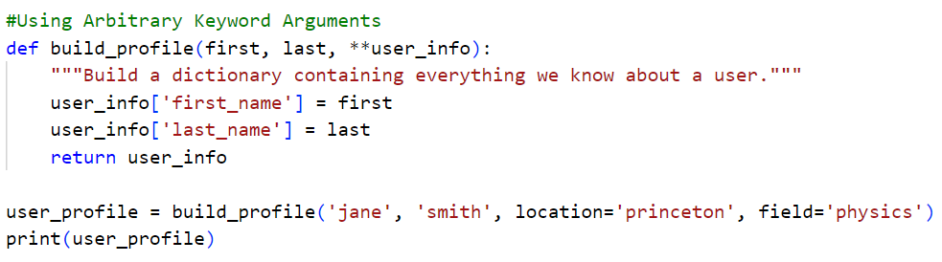
The function build_profile() takes a person's first and last name, along with any additional details passed as keyword arguments (e.g., location, field). The **user_info syntax collects these extra details into a dictionary. The function then returns the complete profile, combining the required names with the optional information. The ** syntax allows for any number of keyword arguments to be stored as key-value pairs. The output starts with location='princeton' because keyword arguments are passed as key-value pairs, and Python keeps the order in which they are passed. Since location='princeton' was provided first in the function call, it appears first in the dictionary.

Slide 21
Storing Your Functions in Modules
A module in Python is a file containing Python code, such as functions, classes, or variables. An import statement tells Python to make the code in a module available in the currently running program file. An alias is a shorthand or alternate name given to a module or function during import, using the as keyword, to make the code more clear or avoid naming conflicts. For example, you can import a module like import pizza as p or a function like from pizza import make_pizza as mp, allowing you to call functions with the alias instead of their full names.

Slide 22
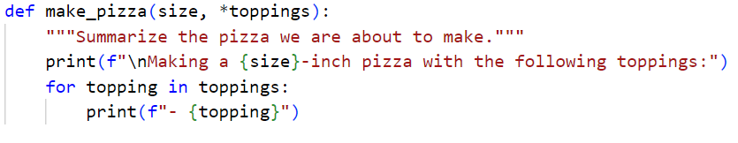
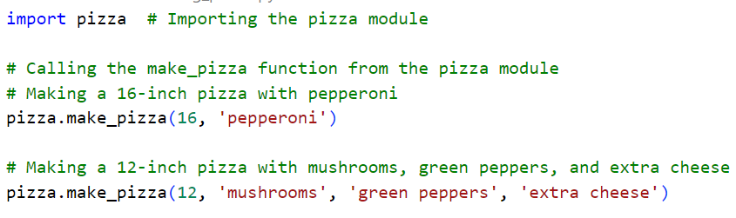
pizza.py (Page 150)
making_pizzas.py

Slide 23
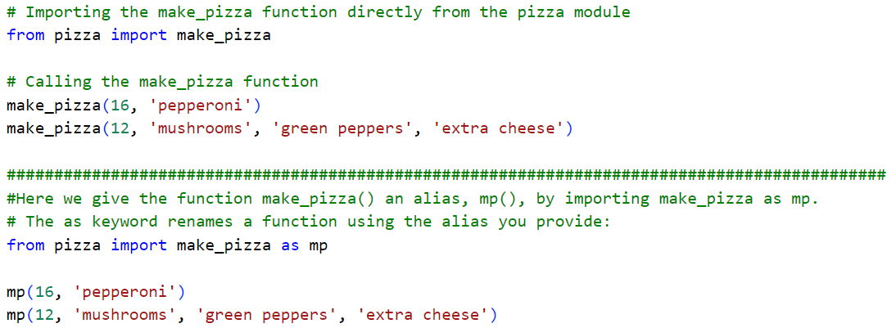
(Page 151)

Slide 24
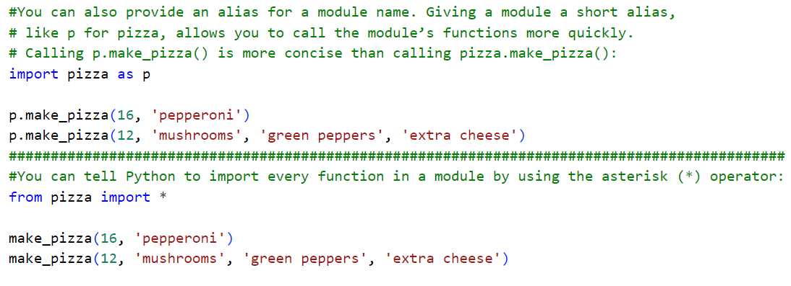
(Page 152)

Slide 25
Styling Functions
When styling functions, use descriptive names written in lowercase with underscores to improve clarity. Both functions and module names should follow this naming convention. Each function should have a clear docstring immediately after the function definition. A docstring is a comment that explains what the function does, the arguments it takes, and the value it returns. It helps other programmers understand how the function works and how to use it, without needing to read through the entire code. Clear documentation makes it easier to trust that the function will work as expected.
PEP 8 GUIDE: https://peps.python.org/pep-0008/

Slide 26
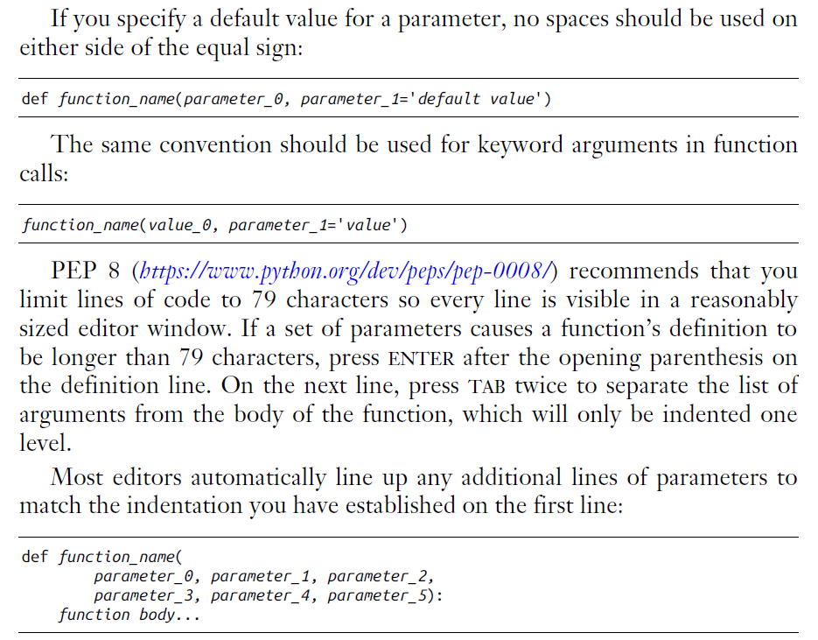

Slide 27
Practice Exercises
Do the following TRY IT YOURSELF on pages:
131
136 to 137 do it
141
146
149
154

Slide 28

End
Of
Chapter 8

